Slide 1

Limit Reference Points and the Fish Stocks Provisions
Break-out Group Exercises for the Joint TESA/NOG Workshop
November 2021

Slide 2
Objectives
Breakout exercises are designed to elicit LRP decision(s) under different circumstances
How and why choices are made?
What considerations or assumptions mattered?
What was challenging and why?
How do rationales change with new information or in different contexts?
How well do decisions and rationales reflect candidate best practice criteria?
There is no “right” answer.
Some approaches may be better than others.

Slide 3
Overview
Breakout group setup
Background on the Species/Stock
Overview of Exercise 1

Slide 4




Setup
Explanation
Discussion
Presentations
Each Day…
Next morning…
~1.5 hours
5 min
Send presentation to Tim.Barrett@dfo-mpo.gc.ca after the session

Slide 5
Setup
47
Group 1
Group 2
Group 3
Group 4
Group 5
Group 6
6 Groups (a lead/co-leads per group)
Groups composition changes each day
Range of levels of experience
Leads will need support
Identify PPT lead
Identify R lead (script is provided)
Identify a presenter for next day

Slide 6

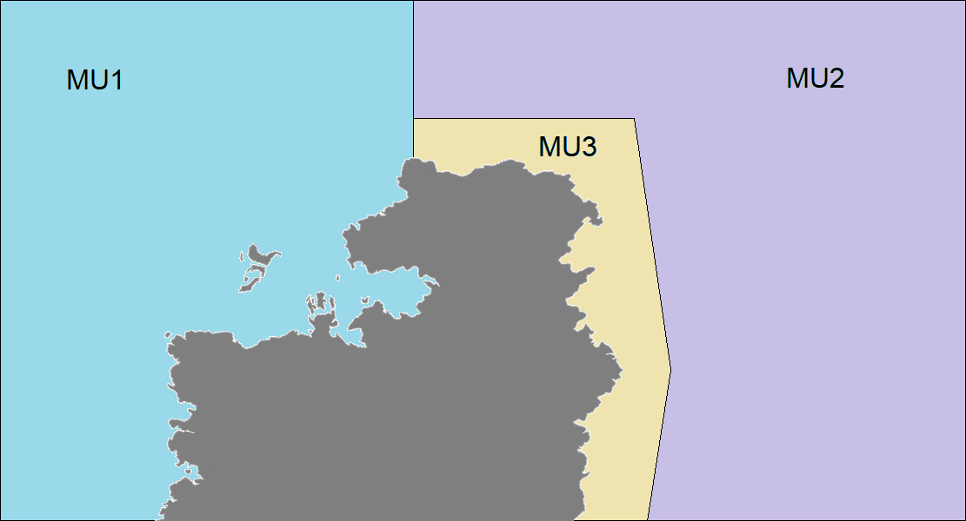
Arctic Sardine
Small pelagic fish
max length ~30 cm, max age ~ 12yrs
~95% mature at age 3, average age of spawners ~ 5 yrs
Stock has 3 management units
Defined based on spawning
locations

Slide 7
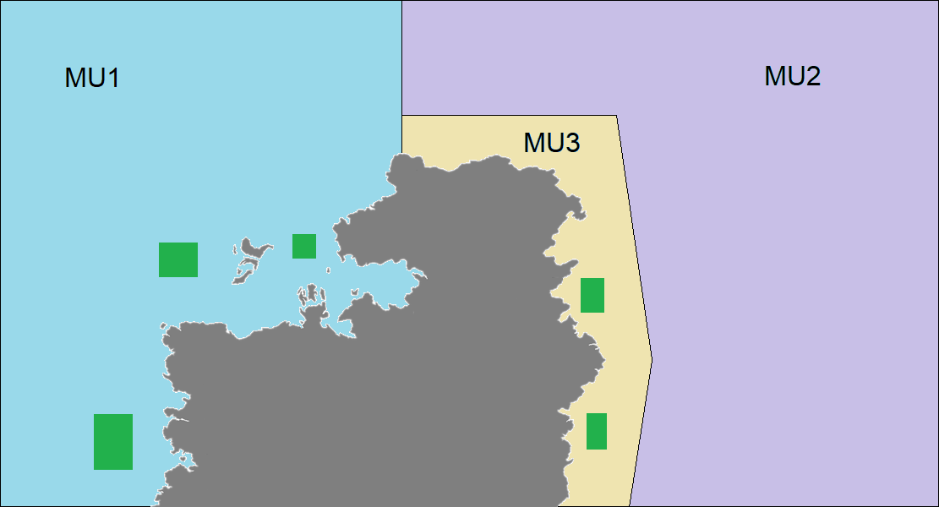
Arctic Sardine
Small pelagic fish
max length ~30 cm, max age ~ 12yrs
~95% mature at age 3, average age of spawners ~ 5 yrs
Stock has 3 management units
Defined based on spawning
locations
Specific offshore spawning locations unknown

Slide 8
Arctic Sardine
It is a schooling fish that migrates and forms predictable aggregations for feeding, overwintering, and spawning
Common spring/summer feeding area
Common overwintering area

Slide 9
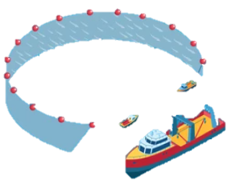
Arctic Sardine – Fall Spawning

Slide 10
Arctic Sardine – Overwintering
Common overwintering area

Slide 11
Arctic Sardine – Spring Summer Feeding
Common spring/summer feeding area
Common overwintering area

Slide 12
Arctic Sardine – Fall Spawning

Slide 13

Exercise 1

Slide 14
Exercise 1
Exercise Goal:
Identify ways to define an LRP for a data-limited “Arctic Sardine” stock, where the “stock” area contains multiple management units.

Slide 15
Exercise 1
The fictional Arctic Sardine stock consists of three management units but would be prescribed to the Fish Stocks Provisions as a single stock. A single LRP would be required for the “stock”.
Consider 2 approaches to defining an LRP:
Entire stock (MU1, MU2, MU3)
MU1 only (most data)

Slide 16
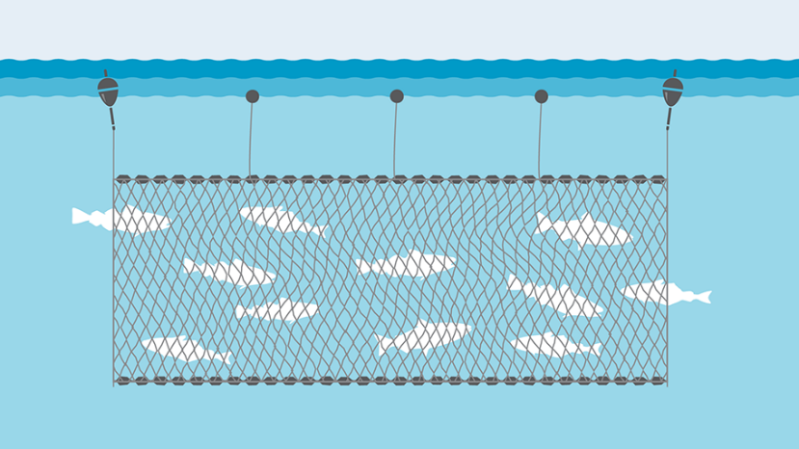

Exercise 1
Catch – 50 years by MU: purse seine or gill net
70% of catch from fall spawning season

Slide 17
Exercise 1
Effort
Number of trips for PS fleet (40 years)
No data
No
data

Slide 18
Exercise 1
Relative index of SSB from acoustic surveys on the spawning grounds in the Fall
Acoustic survey (25 years)
No data

Slide 19
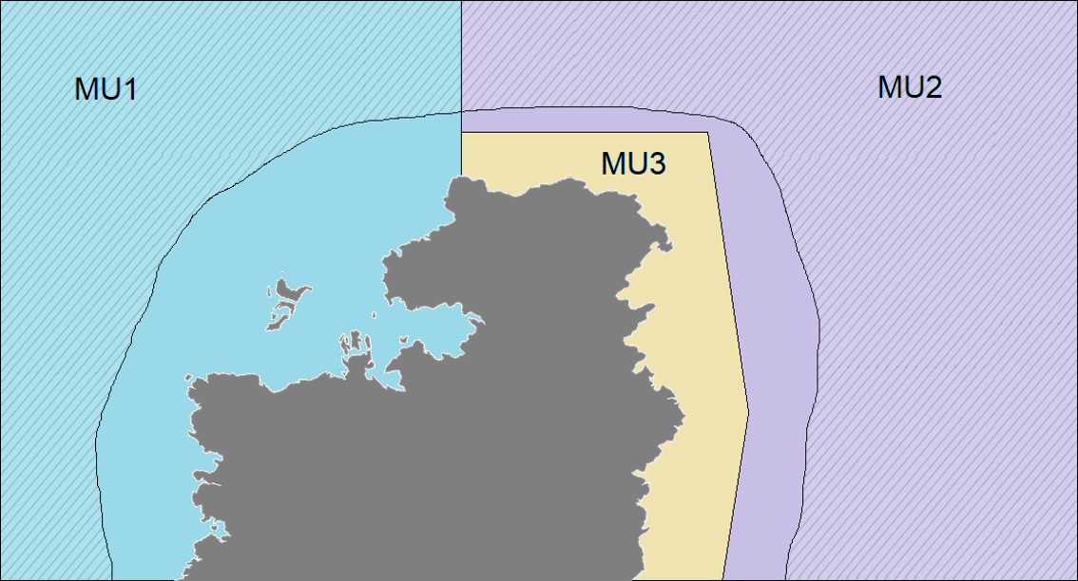
Exercise 1
Relative index of total (benthic) biomass from groundfish bottom trawl survey (Spring)
Survey coverage (42 years)
Common spring/summer feeding area
No data

Slide 20
Exercise 1 Activity

Slide 21
Exercise 1
Open Exercise Document

Slide 22
Exercise 1
A. Establish the base datasets to be used in LRP determination for the entire Arctic Sardine stock.

Slide 23
Good temporal coverage
Good spatial coverage
Survey targets the appropriate habitat
Annual variability in index is high
Poor temporal coverage
Poor spatial coverage
Optimal survey timing
Survey does not target the appropriate habitat
Index is not proportional
to abundance
Copy text boxes and paste in Table below as many times as needed. Add other pros/cons if you want
Catch | CPUE for purse seine fleet | Relative index of total (benthic) biomass from groundfish bottom trawl survey | Relative index of SSB from acoustic surveys on the spawning grounds
Pros
Cons

Slide 24
Exercise 1
We aimed to include an appropriate amount of information
Make assumptions if necessary (e.g., assume suitable survey effort)
You can ask questions in the chat

Slide 25
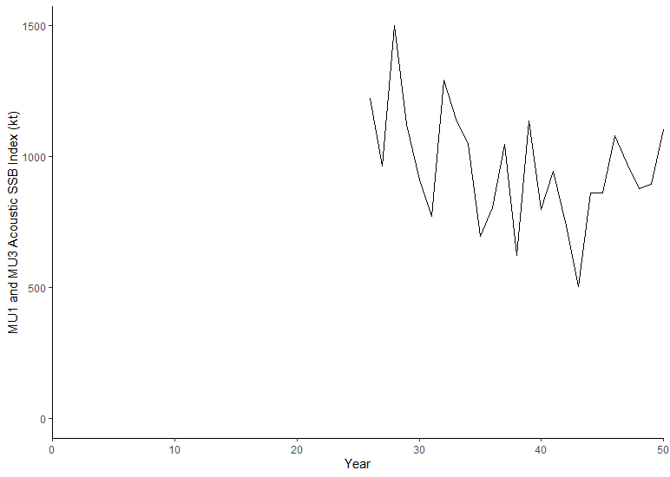
Exercise 1
B. Select a spatial area Entire Stock or MU1
Select an indicator and LRP
C. Pros/cons of choice, rationale for choice
Include a time series plot of the indicator and add a line to represent the LRP.

Slide 26
Exercise 1 Presentation Slides (to share at the workshop tomorrow)

Slide 27
Break Out Group Add Number
Spatial Area:
Indicator:
LRP:
Rationale:
Add plot here
Submit all slides to Tim.Barrett@dfo.mpo.gc.ca when complete

Slide 28
~90 Minutes
Best use of time – task sharing and support for leads
lead for PPT
lead for R
Today will end in the BO groups - when activity is complete (or time expires), the workshop is done for the day.
Remember to send PPT to me
Ask any questions in the main room chat

Slide 29
Exercise 2

Slide 30
Exercise 2
Exercise Goal:
Identify ways to define an LRP for Arctic Sardine MU1 in a data-rich context.

Slide 31
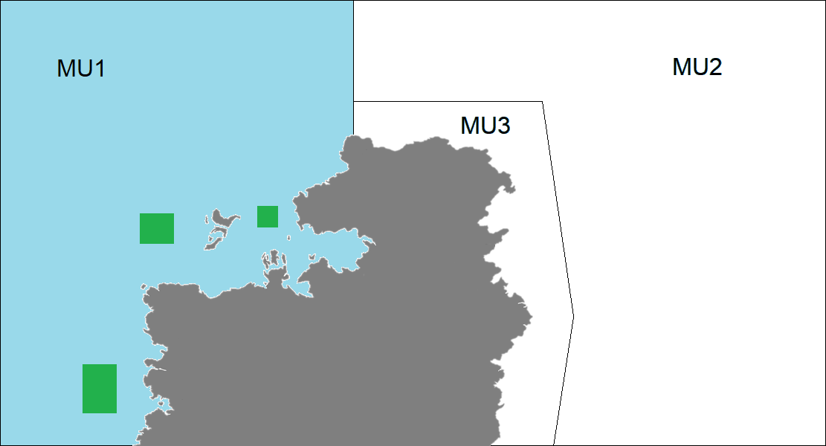
Exercise 2
Age structured model in MU1
B-H SRR with h = 0.75
M = 0.3
Catch and age composition data (50 years)
Acoustic surveys (Index of SSB) (25 years)
A purse seine fleet and a gill net fleet

Slide 32
Exercise 2
System dynamics are assumed to be at equilibrium (i.e., vital rates are assumed to be stationary)

Slide 33
Exercise 2
Open Exercise Document

Slide 34
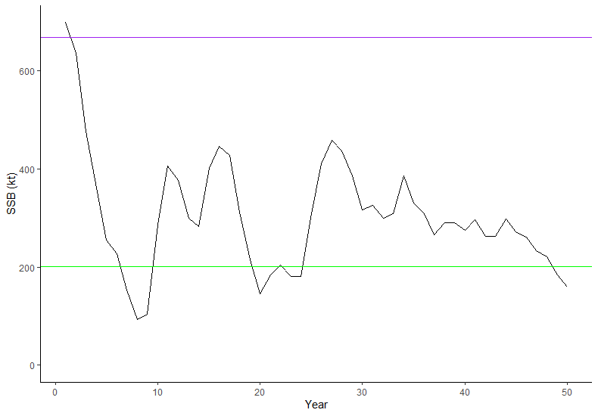
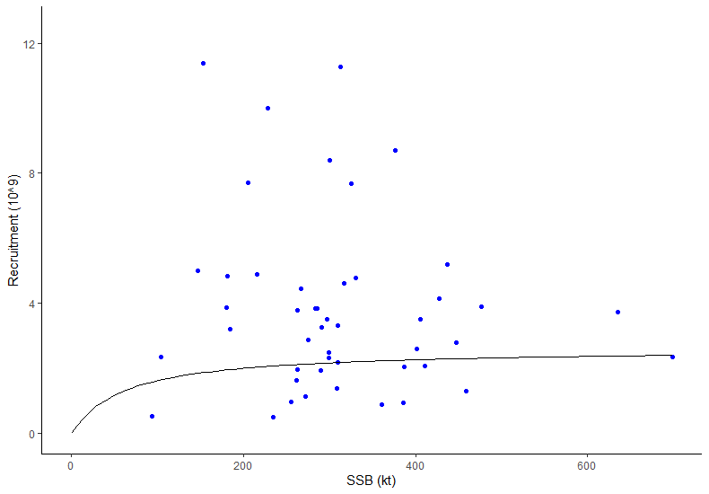
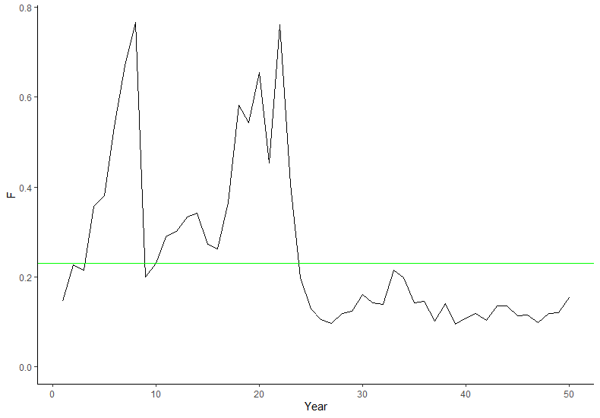
Exercise 2
Some model based approaches:
SSB: %SSB₀, %SSB_{MSY}
SSB based on SRR
F: F_{MSY} (as a removal reference)

Slide 35
Exercise 2
Reference points based on F?
Removal Reference in the PA Policy

Slide 36
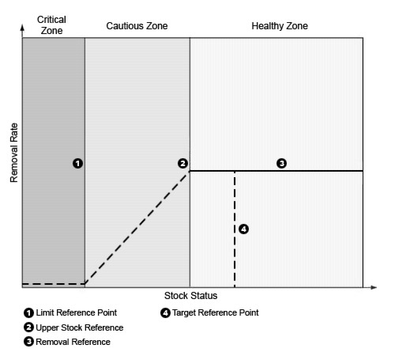
Exercise 2
Complete PA frameworks contain (among other elements):
Limit Reference Point
Removal Reference
(no higher than FMSY)

Slide 37
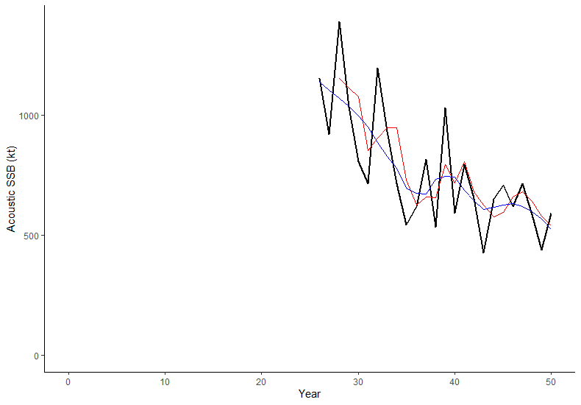
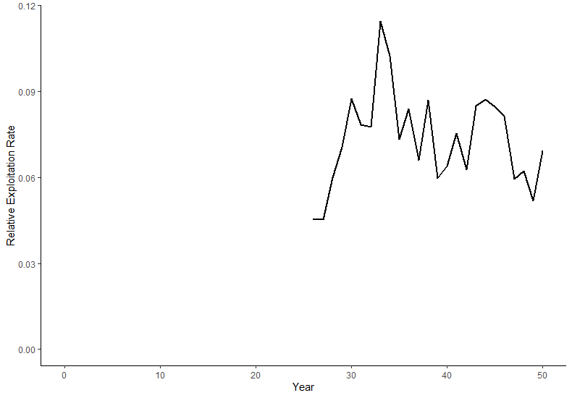
Exercise 2
Some empirical approaches:
SSB: Acoustic index of SSB
F: relative exploitation rate (as a removal reference)

Slide 38
Exercise 2
Q1
Approaches:
Pros
Cons
Q2
Preferred approach:
Best practice criteria?
Assumptions?

Slide 39
Exercise 2
Q4
Add plot here from R
Q3
Advice of LRP breach in short term
Q5
Stock Status in terminal year (year 50)? | How is uncertainty in stock status taken into account?

Slide 40
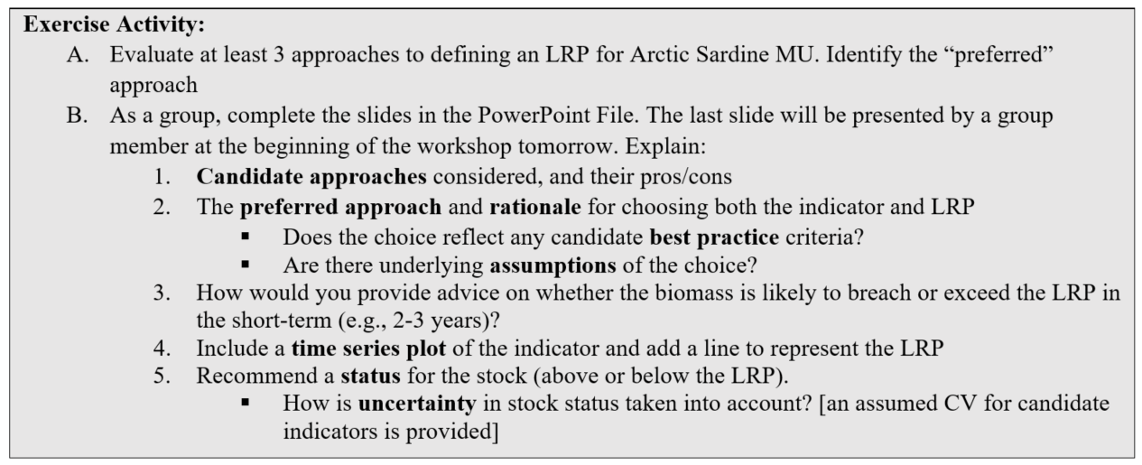
Exercise 2
Focus on comparing different candidate LRPs
If time permits – address questions 3 and uncertainty in status (Question 5)

Slide 41
Exercise 2 Presentation Slide (to share at the workshop tomorrow)

Slide 42
Break Out Group Add Number
Indicator:
LRP:
Rationale:
Stock Status:
Add plot here
Submit all slides to Tim.Barrett@dfo-mpo.gc.ca when complete

Slide 43
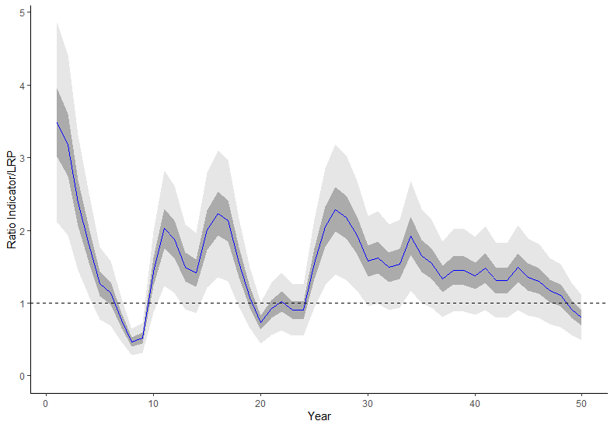
Uncertainty
CV provided for ratio of indicator to LRP

Slide 44
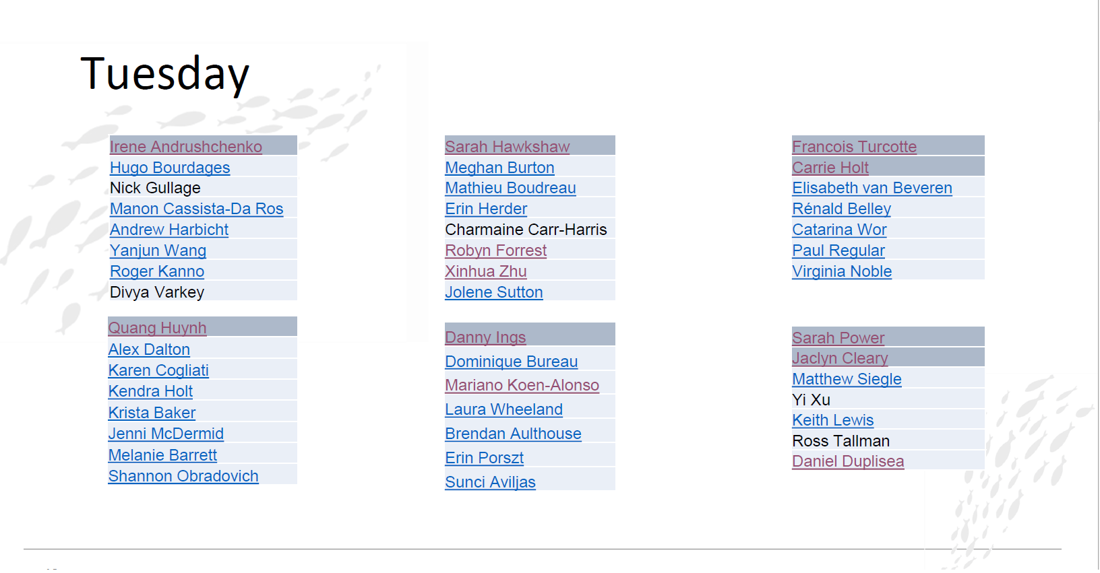

Slide 45
Exercise 3
Complete PA frameworks contain (among other elements):
Limit Reference Point
Removal Reference
(no higher than FMSY)
Why look at both? time-varying productivity impacts SSB and F reference points

Slide 46
Exercise 3

Slide 47
Exercise 3
Exercise Goal:
Identify ways to define an LRP for Arctic Sardine MU1 in a data-rich context with time varying productivity.

Slide 48
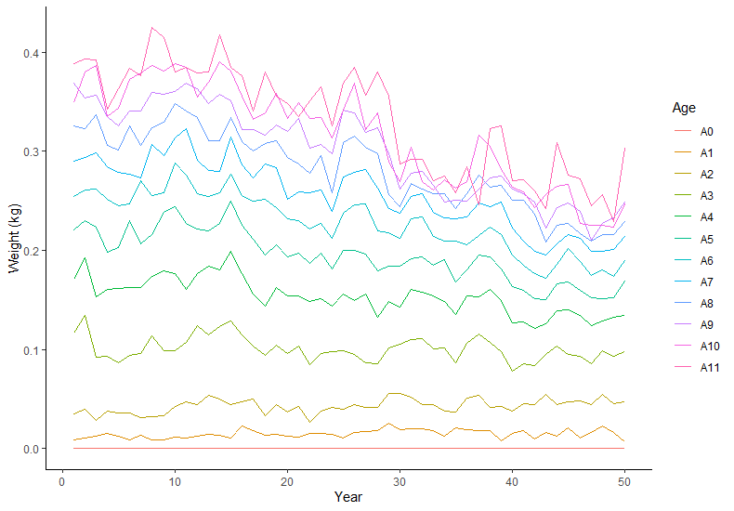
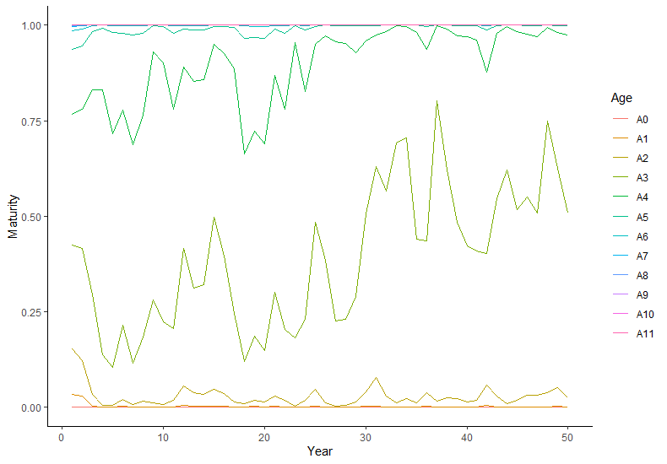
Exercise 3
Weight-at-age and Maturity-at-age

Slide 49
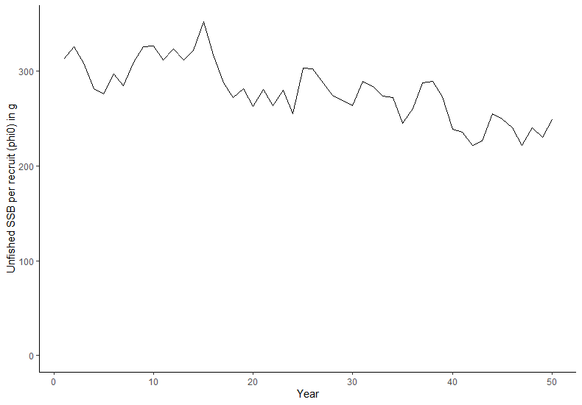
Exercise 3
Unfished SSB per recruit

Slide 50
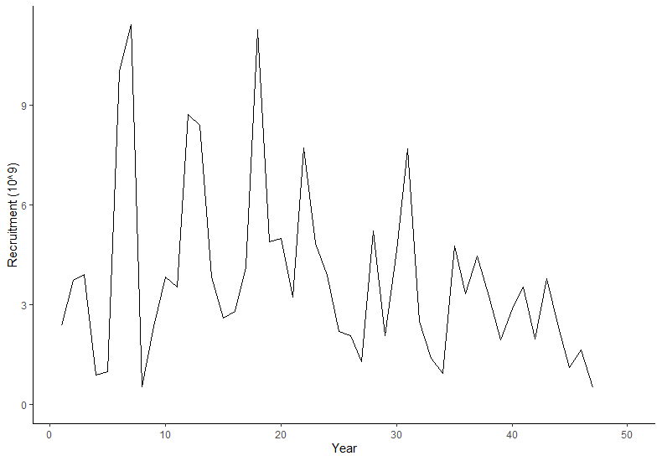
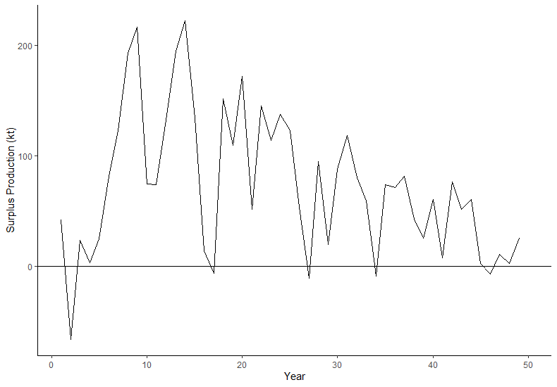
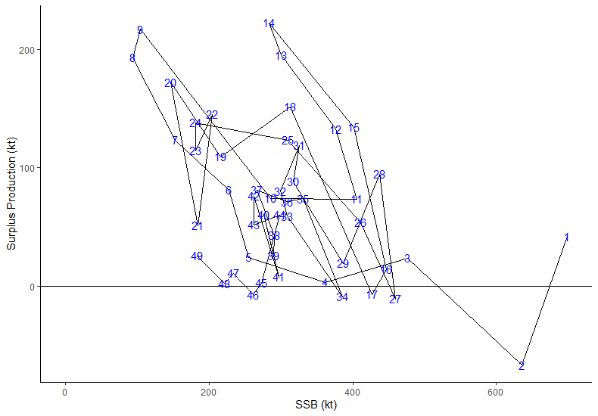
Exercise 3
Surplus Production

Slide 51
Exercise 3
Open Exercise Document

Slide 52
Candidate Approaches
“Equilibrium” SSB₀ or SSB_{MSY}
SSB per recruit (phi₀) is changing over time
Can define phi₀ over different time periods
Mean over x years in time series
Mean over entire time series
SSB based on F_{X%SPR}

Slide 53
Candidate Approaches
Dynamic SSB₀
Equilibrium assumptions assume mean recruitment from the SRR and biological parameters over a specified time period (e.g., last 10 years of time series) to estimate SSB per recruit (phi₀)
A dynamic SSB₀ can be estimated by projecting SSB from the beginning of the time series to the terminal year of the reconstruction in Year 50 with F=0 using the recruitment deviations from the model fit with the historical catch

Slide 54
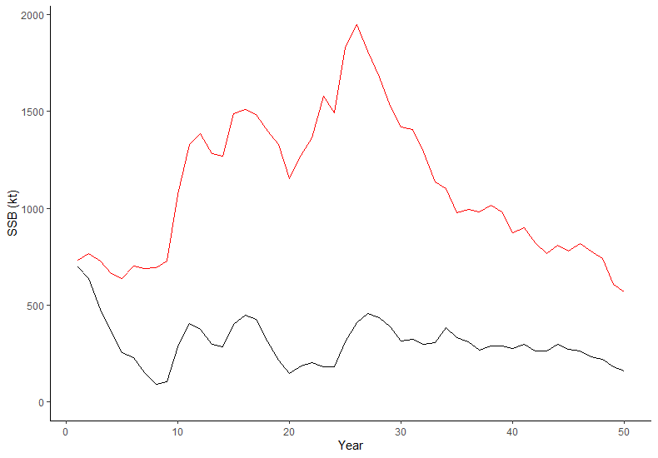
Dynamic SSB₀

Slide 55
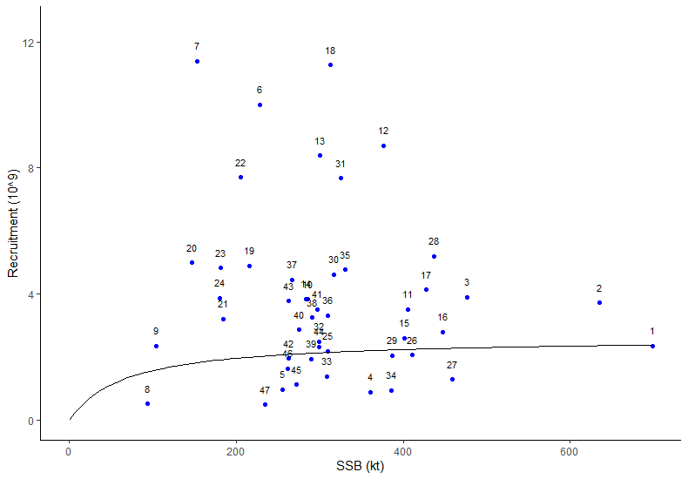
Dynamic SSB₀
No fishing
Annual weight-at-age
Annual maturity-at-age
Annual recruitment deviation

Slide 56
Dynamic SSB₀
No fishing
Annual weight-at-age
Annual maturity-at-age
Annual recruitment deviation

Slide 57
Dynamic SSB₀

Slide 58
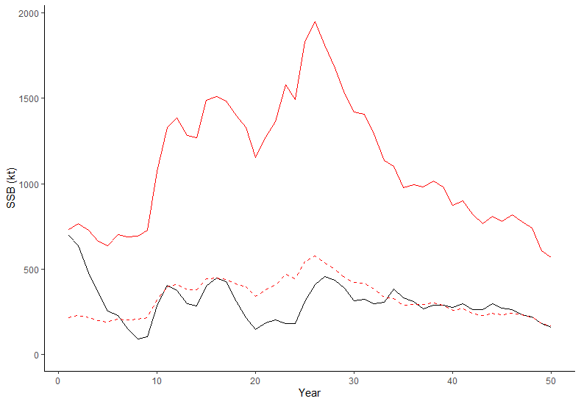
Candidate Approaches
Dynamic SSB_{MSY}
We can estimate the ratio of equilibrium SSB_{MSY}/ equilibrium SSB₀
Dynamic SSB_{MSY} = this ratio × Dynamic SSB₀

Slide 59
Candidate Approaches
SSB_{Recover}
Some different considerations for changes in productivity over time

Slide 60
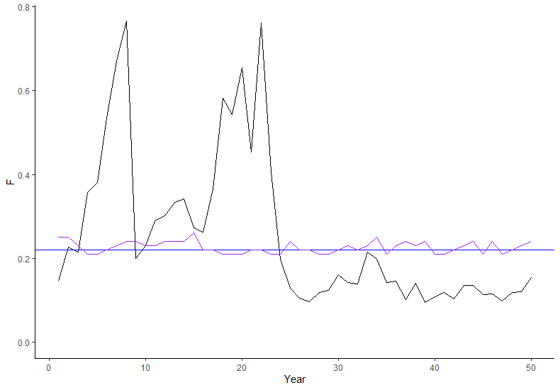
Candidate Approaches
F_{MSY}
Equilibrium F_{MSY} using annual growth, maturity, and vulnerability
Equilibrium F_{MSY} using mean growth, maturity, and vulnerability over some time period

Slide 61
Candidate Approaches
Empirical approaches
Acoustic SSB index
Relative exploitation rate (Catch/smoothed Index)

Slide 62
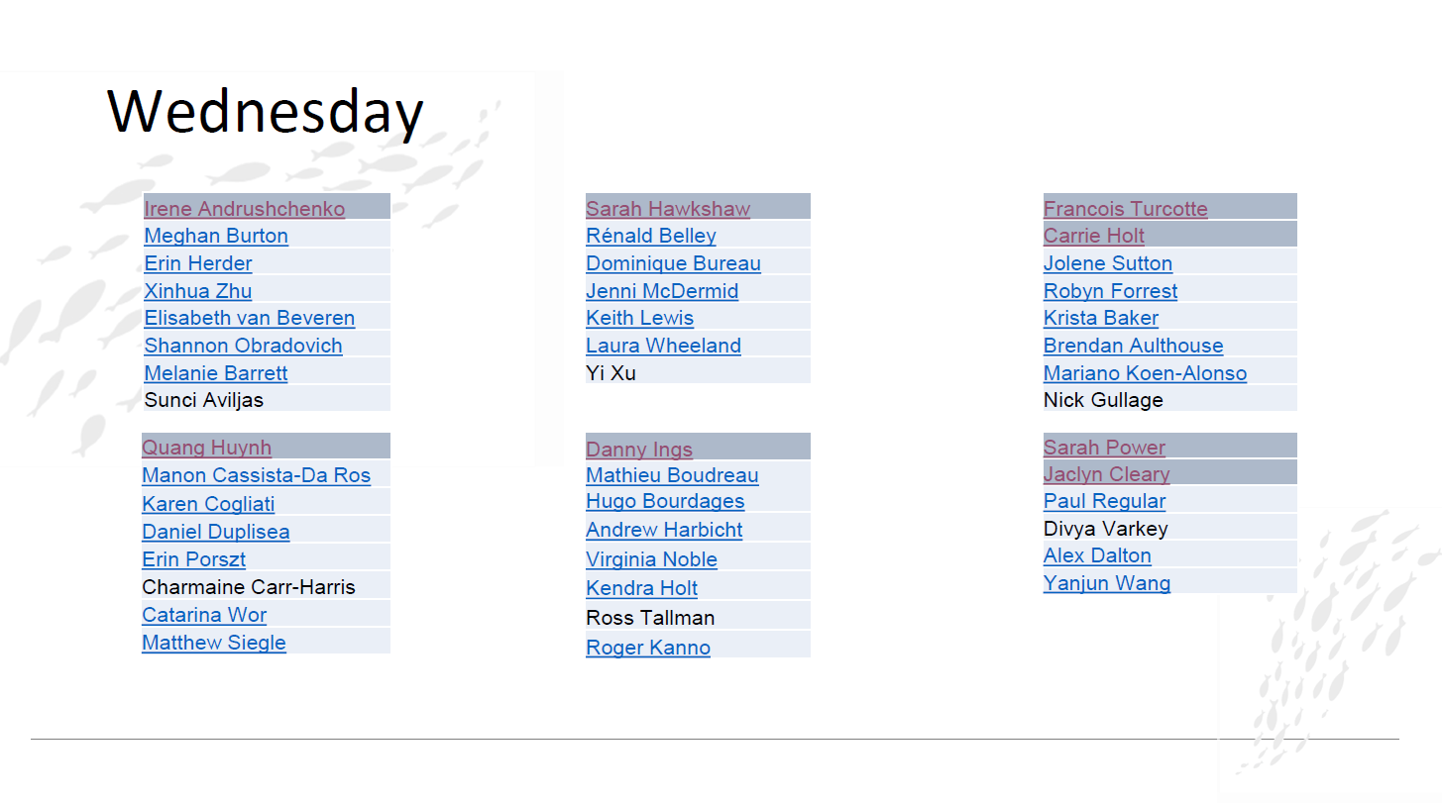

Slide 63
Exercise 4

Slide 64
Exercise 4
Exercise Goal:
Identify ways to define a single metric of stock status for Arctic Sardine MU1 in a data-rich context when there is more than one model that is an acceptable characterization of the population dynamics.

Slide 65
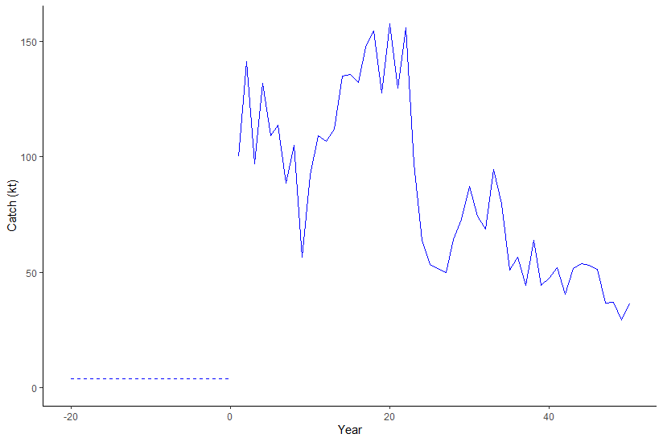
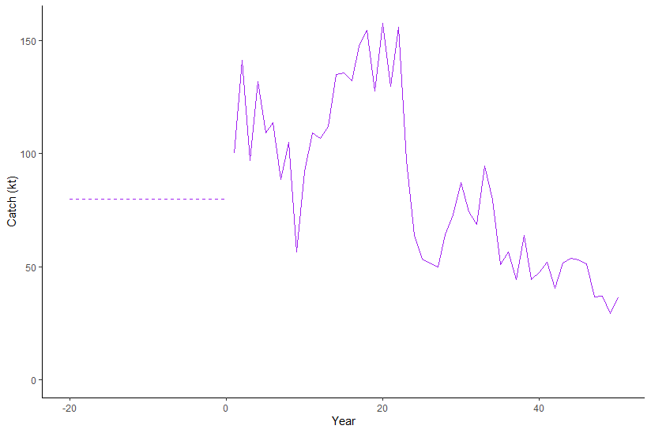
2 Models with Different Assumptions for Historical Catch
Assume that prior to year 1 of the time series, there were international fleets fishing Arctic Sardine and the magnitude of those historical catches is unknown.

Slide 66
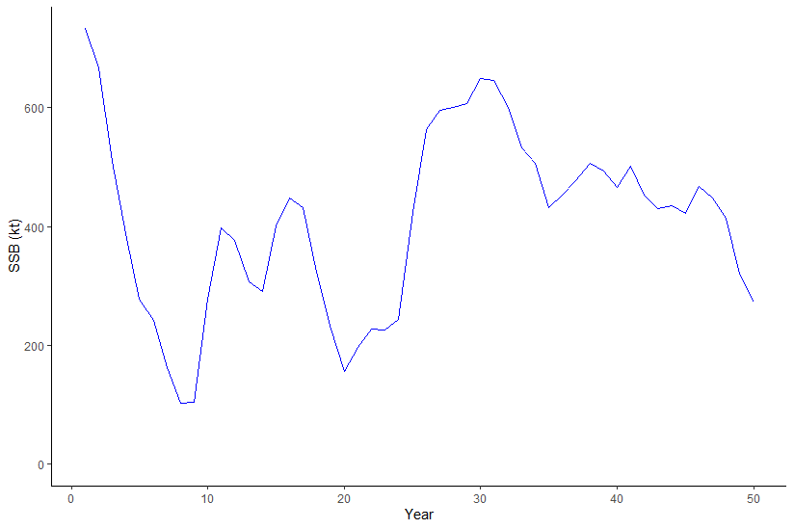
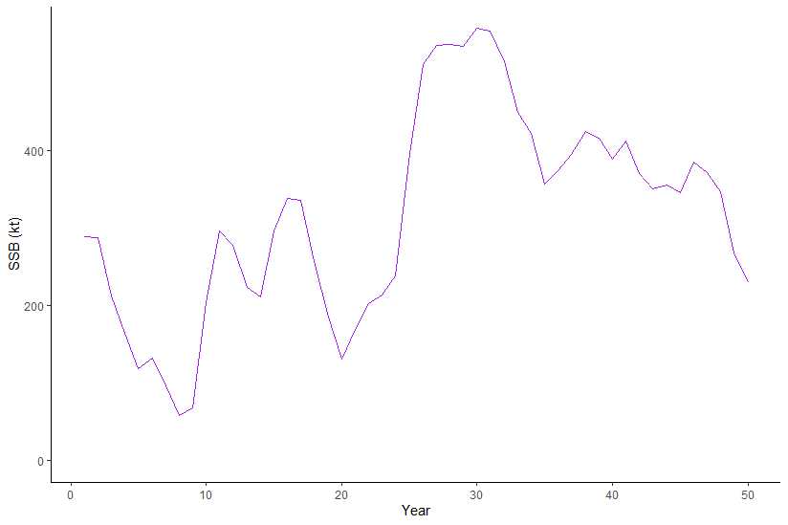
Exercise 4
Assumption influences the initial depletion

Slide 67
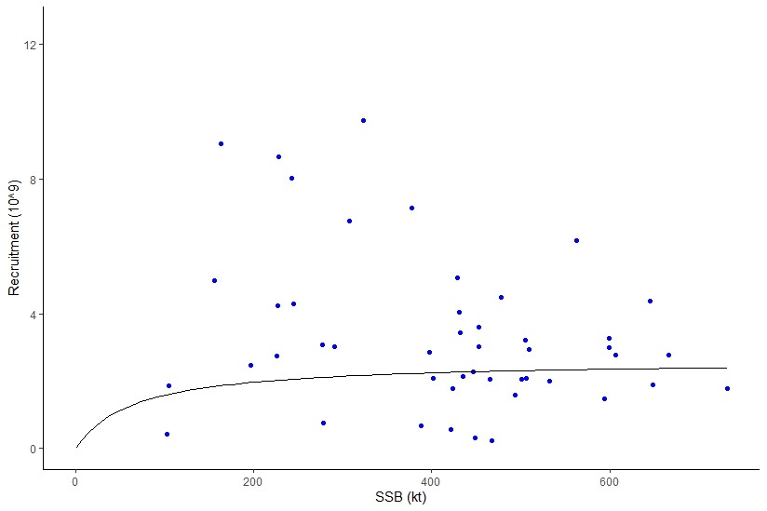
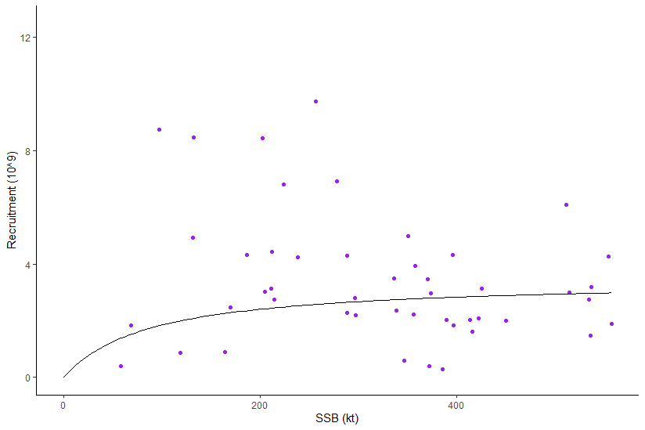
Exercise 4
Assumption influences the initial depletion
R₀, SRR, and therefore B₀ and B_{MSY} reference points

Slide 68
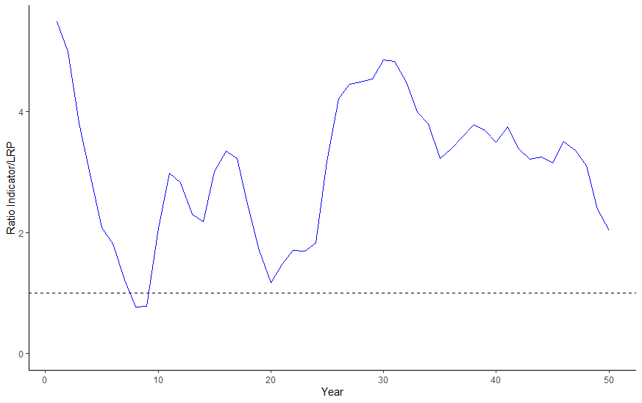
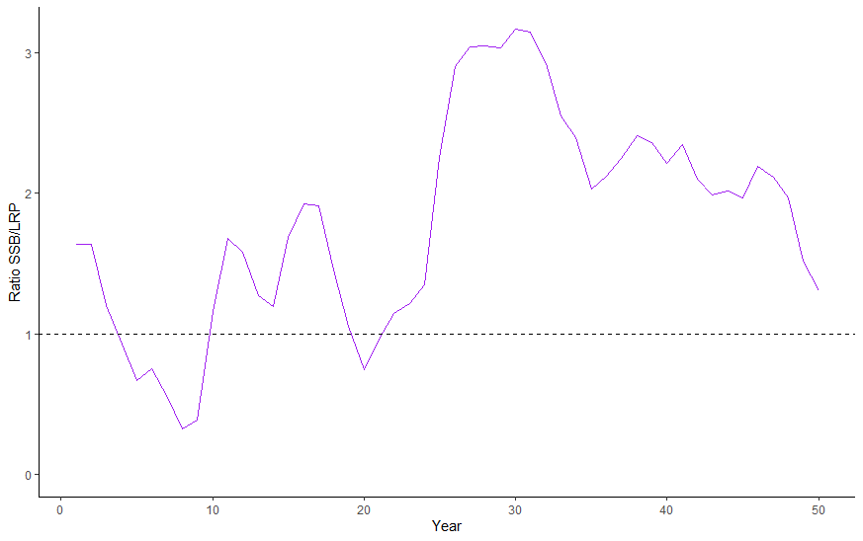
Exercise 4
Evaluate at least 2 approaches to defining a metric of stock status for Arctic Sardine MU1 and identify the preferred approach.
We can use an LRP of 0.2SSB₀

Slide 69
Exercise 4
Some options:
Model-based indicator based on one model
Model-based indicator based on multiple models (mean, weighted mean base on plausibility)
Empirical indicator (e.g., acoustic index of SSB, relative exploitation rate)

Slide 70
Exercise 4
Don’t focus too much on the specific example (unknown catch)
Focus on the general issue of defining status when you have multiple plausible hypotheses
Pros and Cons of the different options
How would uncertainty be captured?

Slide 71
Break Out Group Add Number
Stock status indicator:
Stock status:
Add plot here
Submit all slides to Tim.Barrett@dfo-mpo.gc.ca when complete

Slide 72
